Slide 1
CSE518A: Office Hour (till 4pm)

Slide 2
Lecture 13 Real-time Crowdsourcing
Instructor: Chien-Ju (CJ) Ho

Slide 3
Logistics: Assignment 3 and Project Milestone 1
Assignment 3: Due Oct 27 (Tue)
Project milestone 1: Due Oct 30 (Fri)
Initial literature survey (know what other works are out there)
A plan on what you want to do for the remaining of the semester
Formalize your research question and approaches, e.g.,
Theory/simulation project: formalize your models
Data-analysis project: figure out where and how to get data and what you plan to do with it
Experiment/application project: have a prototype design and an evaluation plan
Include a timeline (weekly or biweekly) on what you plan to do

Slide 4
Logistics: More about Assignment 3
Understanding conditional probability
For problem 2 (b,c)
Grader 1 and grader 2 are reviewing the same assignment
Grader 1 receives signal B
What’s the probability of grader 2 also receiving signal B?
It’s different from Pr(B), the probability for a grader to receive signal B for an assignment randomly drawn from all assignments

Slide 5
Logistics: Project Milestone 2
Milestone 2: Due Nov 20
Summarize your progress
Last chance to convert a research project to an extensive literature survey
What’s the expected amount of literature survey?
Case by case
As a general guideline, the minimum number of papers
For research project: 3~5 papers (# papers in one lecture)
For literature survey project, 15~20 papers (# papers in one “topic”)

Slide 6
Logistics: Project Midterm Pitch and Discussion
Milestone 2: Due Nov 20 (Friday)
Midterm Pitch: Nov 19 (Thu), in lecture
More details to come
Tentative formats:
Every team gives a spotlight presentation for 1~2 min
The entire class splits into 2~3 big groups
Each team in turn obtains the entire attention of the big group
Using this time to collect data, obtain feedback, elicit suggestions, etc
Try to think about what you can do with this time in your milestone 1 plan and utilize it
Let me know early if it’s helpful to utilize the entire class for help
Might be able to allocate a small amount of time in a need basis

Slide 7
Crowds in Two Seconds: Enabling Real-time Crowd-Powered Systems.
Michael Bernstein, Joel Brandt, Robert Miller, and David Karger. UIST 2011

Slide 8

Crowds in Two Seconds

Slide 9

Real-time Crowdsourcing: Why
Enable interactive systems
Users can’t stand long waiting time
Enable synchronous crowds
Multiple workers can work together for tasks
There might be other ways to achieve this:
Set a task start time, invite workers back at the given time

Slide 10
Real-time Crowdsourcing: How
Retainer models
Pay workers to wait
Better interface design (alerts)

Slide 11
Real-time Crowdsourcing: How
Rapid refinement
Using AI to help focus on more “important” tasks
We might apply similar ideas for annotation tasks.

Slide 12
Real-time Crowdsourcing: How
Predict the need [Bigham et al., UIST 2010]
Tasks involve a sequence of actions
Start recruiting the crowd before they are needed

Slide 13
Real-time Crowdsourcing: What

Slide 14
Real-time Crowdsourcing: What

Slide 15
Real-time Crowdsourcing: What

Slide 16
Discussion
Review questions
What are the other applications that could benefit with real-time crowdsourcing?
What do you think workers' opinions would be on the retainer model? What kind of worker population do you think this method would attract? And what might be the impacts to the data?
Criticisms/improvements on the approaches they take?
Other approaches to enable/improve real-time crowdsourcing?

Slide 17
A Few More Applications

Slide 18
VizWiz [Bigham et al. UIST 2010]
Answer Blind People’s Visual Questions

Slide 20
Enhancement to Real-time Crowdsourcing
Predict the need
Recruit workers before the questions are asked

Slide 21
VizWiz [Bigham et al. UIST 2010]
Leads to a long line of research to assist blind people
https://vizwiz.org

Slide 22
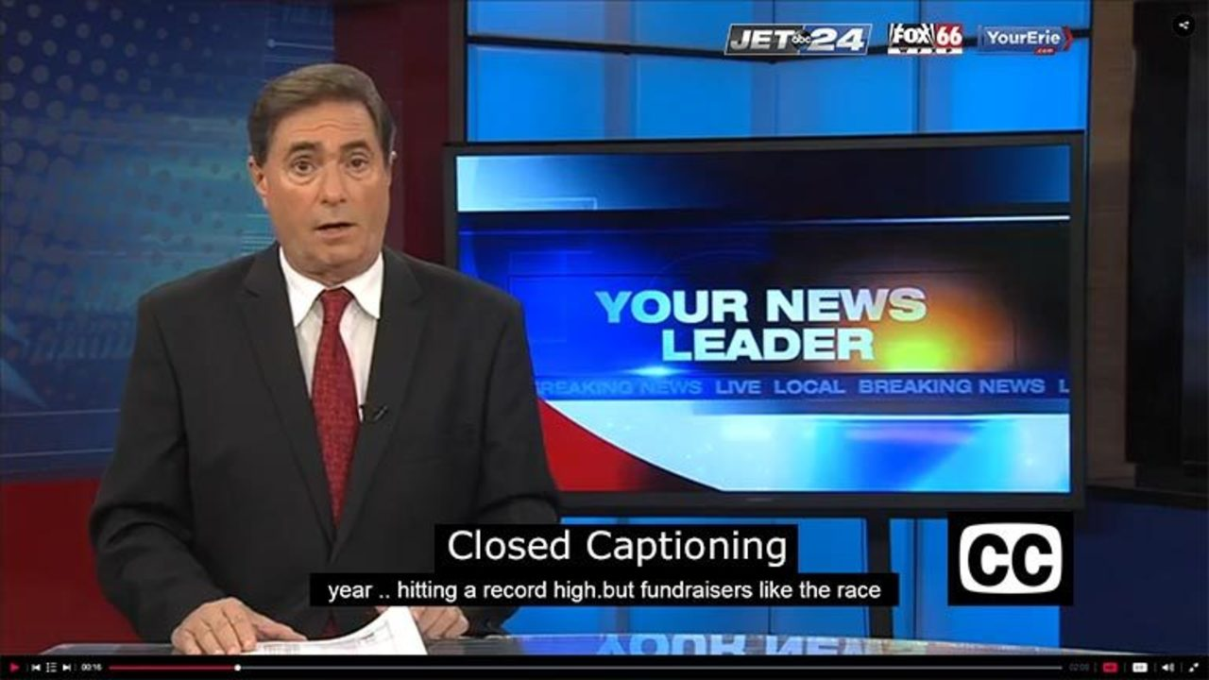
Real-time Captioning [Lasecki et al. UIST 2012]

Slide 23
Real-time Captioning [Lasecki et al. UIST 2012]
Trained exert to type over 225 words per minute
Hard for a single un-trained expert to do real-time captioning
Utilize multiple workers
Each of them working on overlapping small segments (for verification)

Slide 24
Real-time Captioning [Lasecki et al. UIST 2012]
Need to aggregate time-series of data
Multiple sequence alignment

Slide 25
Real-time Captioning [Lasecki et al. UIST 2012]
Captioning might be solvable by AI now (especially for English)
Main ideas might still apply for other applications:
Real-time translation, etc

Slide 26
Crowd-Powered Chatbot [Huang et al. HCOMP 2016]
There are impressive progress in Chatbots, but it’s still not good enough
A crowd play as a chatbot by
Propose responses
Vote for the best one
Take notes
Intermediate solutions; dataset generation

Slide 27
Crowd-Powered Chatbot [Huang et al. HCOMP 2016]

Slide 28
Auto-Evolving Crowd Chatbot [Huang et al. CHI 2018]
Train AI chatbots with historical data
A crowd consists of both humans and AIs
Propose responses
Vote responses
May even consider dynamically determining the ratio of AIs

Slide 29
Auto-Evolving Crowd Chatbot [Huang et al. CHI 2018]

Slide 30
AI Task Delegability [Lubars and Tan. NeurIPS 2019]
Determine what tasks should be done by AI and what tasks should be done by humans.

Slide 31

Twitch Plays Pokemon
https://www.twitch.tv/twitchplayspokemon

Slide 32
Twitch Plays Pokemon
Guinness World Record:
"the most participants on a single-player online videogame" with 1,165,140
Best Fan Creation in Game Award 2014
An application “for fun”, not to “solve problems”
Highlight an interesting question
How should we decide which action to take?
Challenging for sequential actions under real-time constraints

Slide 33
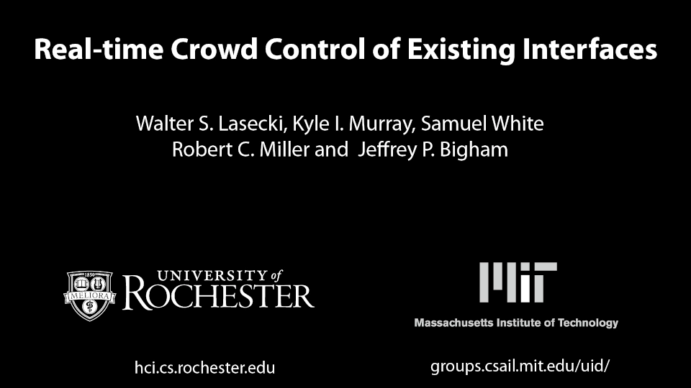
Example: Crowd Robot Navigation [Lasecki et al. UIST 2011]

Slide 34
Discussion
What do you think are the efficient ways for crowd control?
You can use the robot navigation as the application.
Or imagine you are together with 10 other people in a critical environment. You together need to make a series of decisions to survive under time pressure. What’s the mechanism you think you should use?

Slide 35
Crowd Robot Navigation [Lasecki et al. UIST 2011.]
Solo: Hire a single worker
Mob: Pass on all inputs to the original interface (first come first serve)
Vote: Follow actions by majority vote
Leader:
Update “weights” of users based on agreements with the crowd
Follow the actions by the leader (which might change over time)
Active:
Randomly select a worker as the leader, change worker if the input is not in on time

Slide 36
Crowd Robot Navigation [Lasecki et al. UIST 2011.]
Performance measure
Number of success (out of 10)
Average time to complete the task when succsess

Slide 37
Generally, how to aggregate preferences from a crowd?
Social choice theory

Slide 38
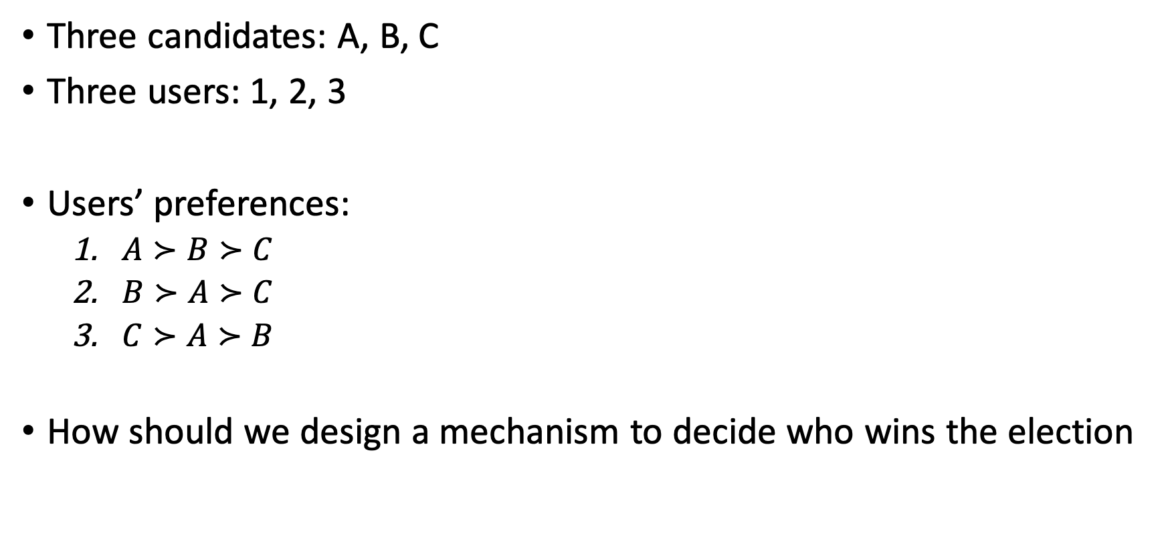
Consider Elections
Three candidates: A, B, C
Three users: 1, 2, 3
Users’ preferences:
$A≻B≻C$
$B≻A≻C$
$C≻A≻B$
How should we design a mechanism to decide who wins the election

Slide 39
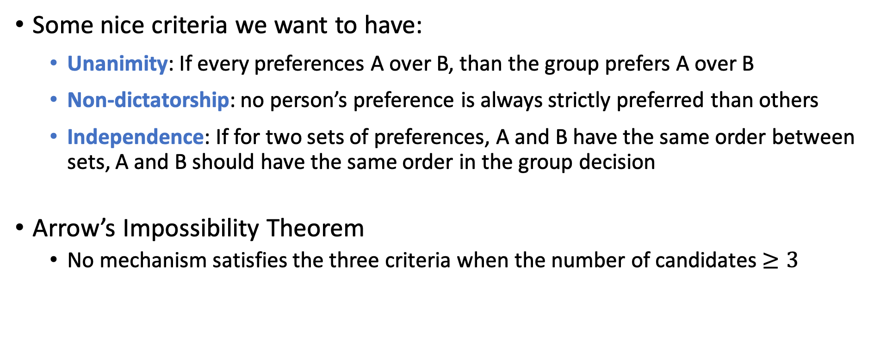
Arrow’s Impossibility Theorem
Some nice criteria we want to have:
Unanimity: If every preferences A over B, than the group prefers A over B
Non-dictatorship: no person’s preference is always strictly preferred than others
Independence: If for two sets of preferences, A and B have the same order between sets, A and B should have the same order in the group decision
Arrow’s Impossibility Theorem
No mechanism satisfies the three criteria when the number of candidates $≥3$

